Slide 1
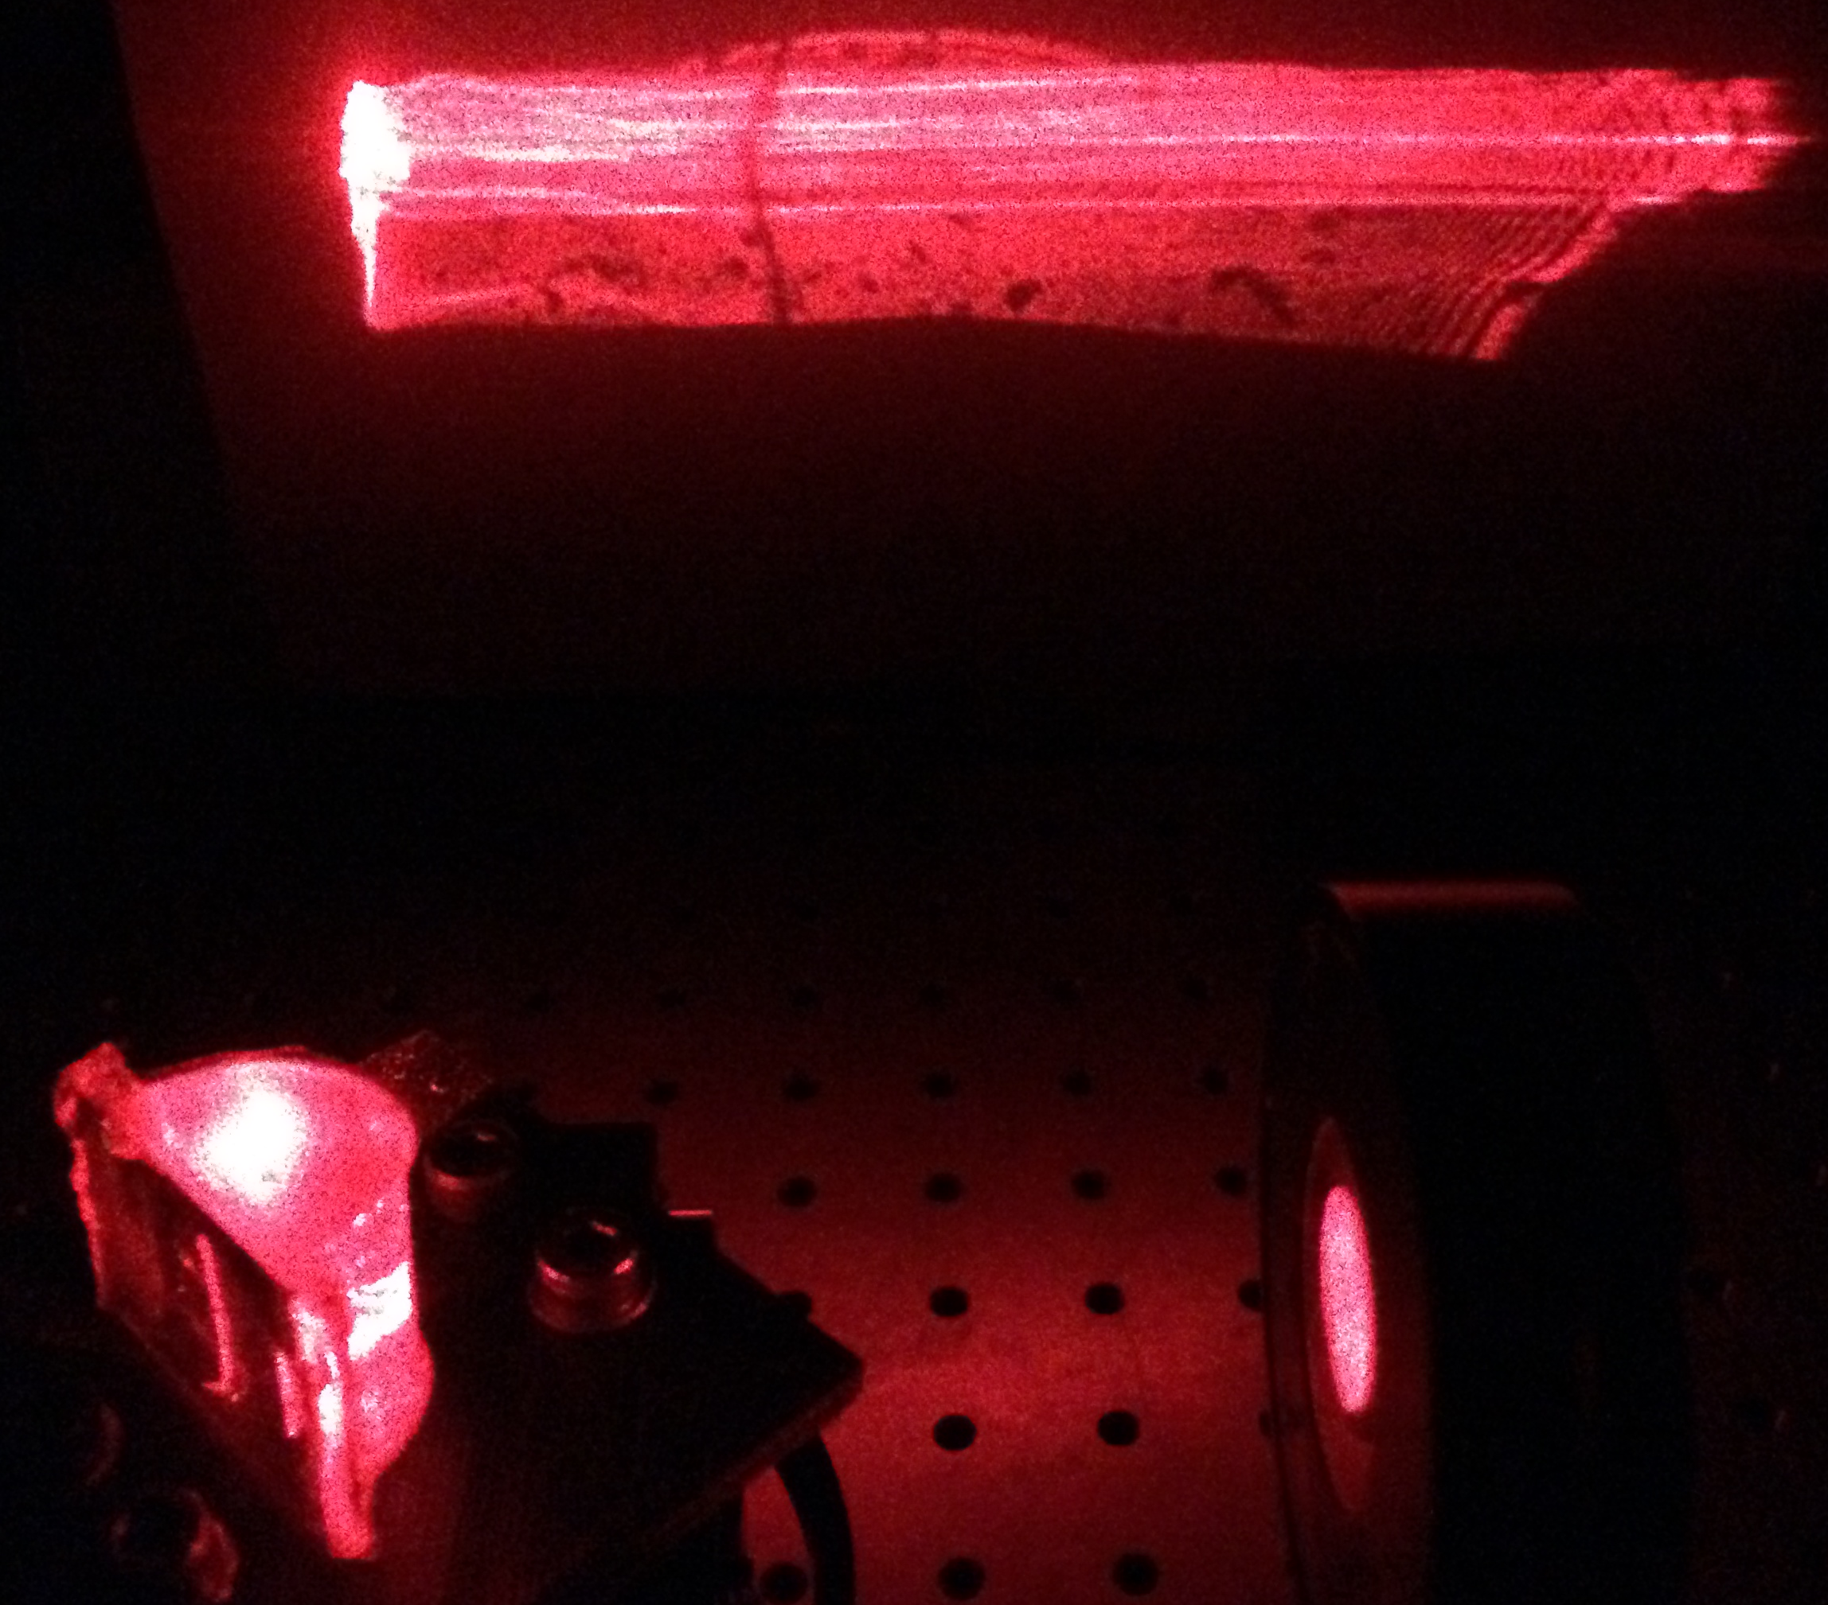
Broad-angle coupling to Surface Plasmons using circular PDMS prisms.
Pierre, Eugene Valassakis
Supervisor: Dr. Andrea Di Falco
Synthetic Optics Group

Slide 2
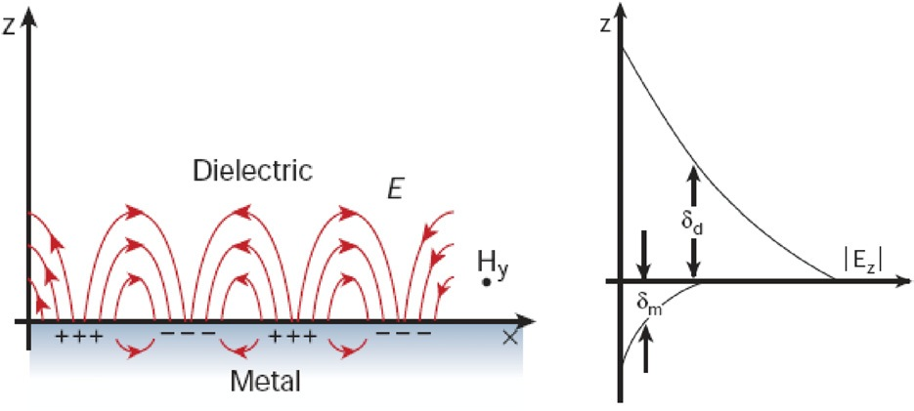
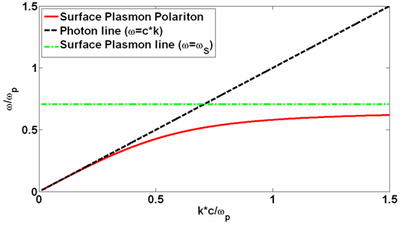
Surface Plasmons
Surface plasmon polaritons (SPPs) are electromagnetic excitations confined at a metal/dielectric boundary, which are coupled to electron oscillations within the metal.
SPPs cannot be directly excited by photons due to a fundamental momentum mismatch with incoming light.
Coupling techniques are needed to provide the extra momentum.
Illustration of SPPs. Taken from [1]
Many techniques exist, the simplest consisting of having the photons incident through a different dielectric with higher permittivity.
[1] Zhang, J., Zhang, L. and Xu, W. 2012. Surface plasmon polaritons: physics and applications. Journal of Physics D: Applied Physics, 45 (11), p. 113001.
[2] Bora Ung, 5 Surface plasmon polaritons: theoretical framework, Collection Mémoires et thèses électroniques, Université Laval, 2007, available at : http://theses.ulaval.ca/archimede/fichiers/24879/ch05.html [visited January 8 2014]
Dispersion relation of SPPs and light line. Taken from [2]

Slide 3
Motivation and Purpose
Develop a non restrictive technique that would allow coupling to SPPs onto flexible substrates.
Quite a general device: Could have an impact on a variety of fields.
Proposed Method:
Use Shaped PDMS prisms
Idea already spotted in the industry, but uses extended and rigid systems.
The investigation involved:
Modelling for the coupling capabilities of curved prisms.
Fabrication and characterisation of the circular prisms.

Slide 4
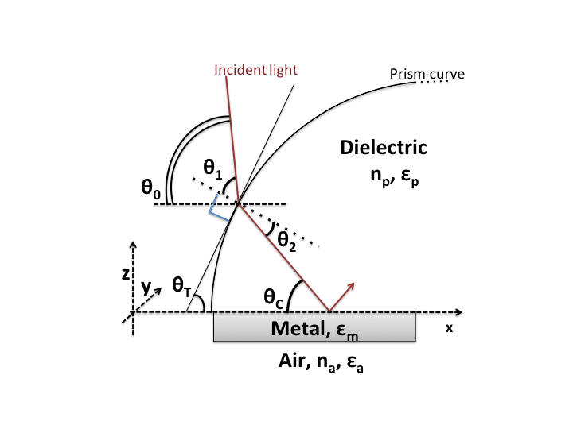
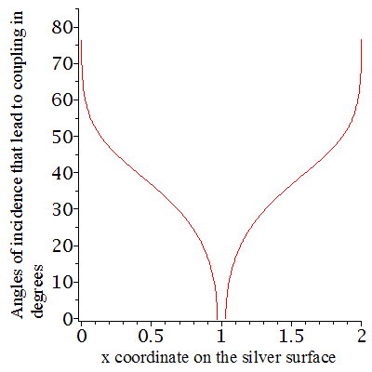
Prism Design
Curvature leads to a range of available momenta that allow for broad-angle coupling.
θ₀= angle of incidence ,f = functional form of the prism curvature, ε_{a,m,p} =dielectic constants of the air, metal and prism respectively ,n_{p,a}=refractive indices of the air and prism respectively
System configuration and parameters
Angles of incidence leading to coupling
for the different prism shapes.
Circular
prism:
Triangular
prism:

Slide 5
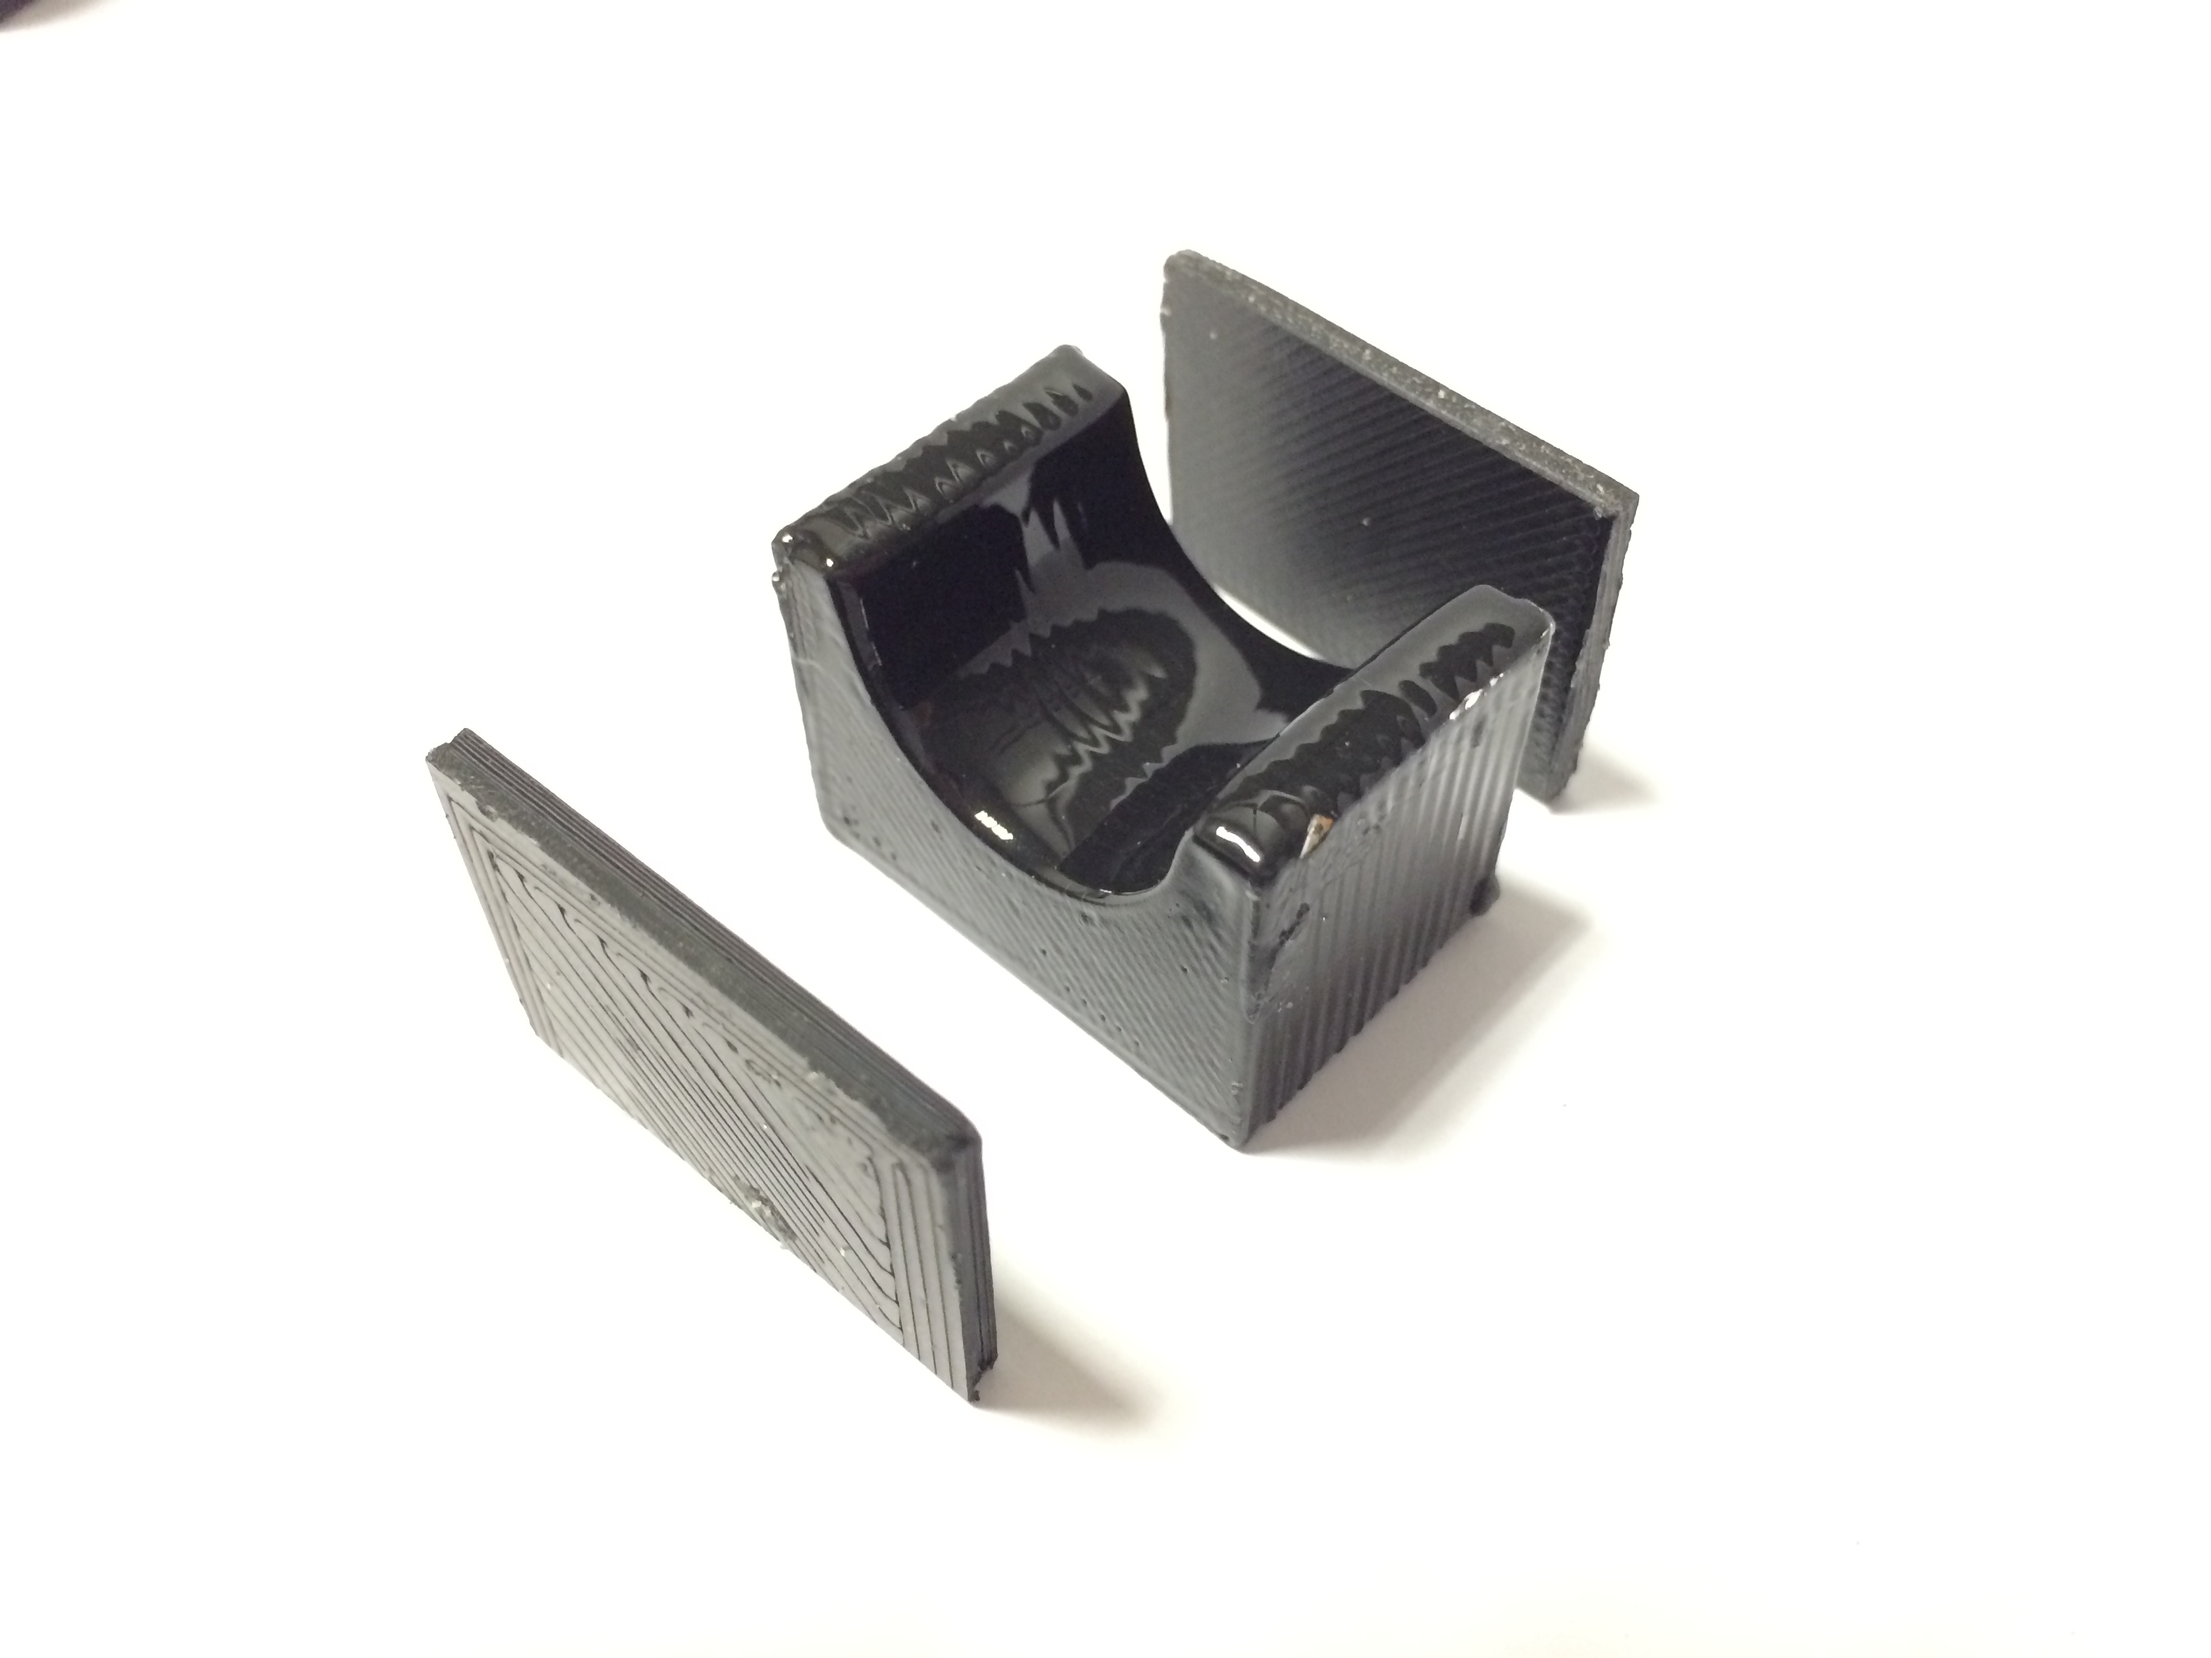
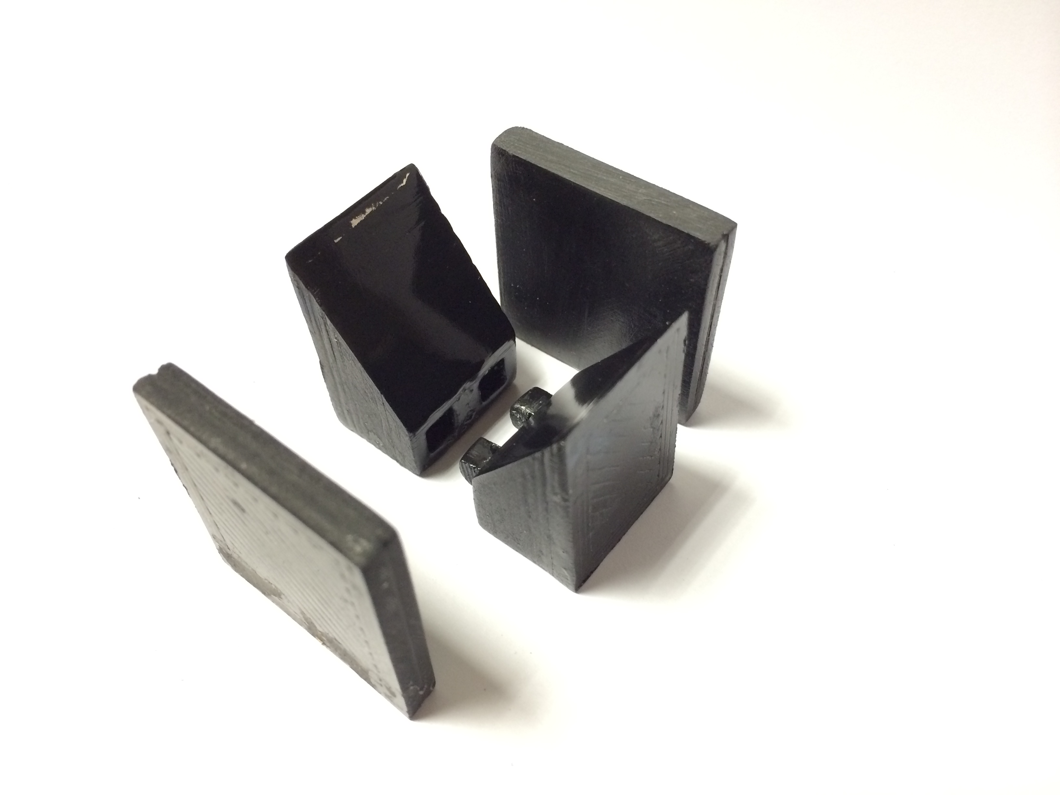
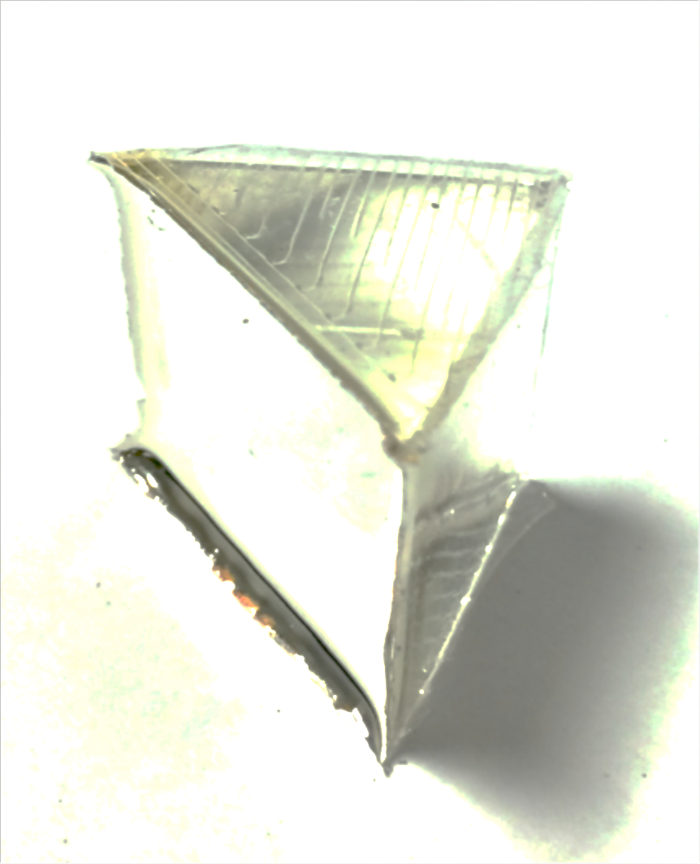
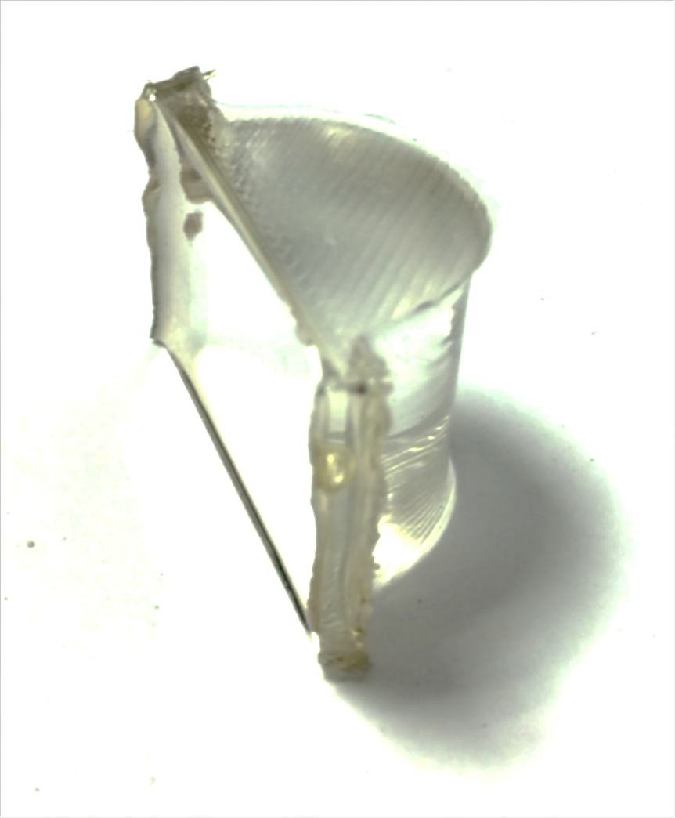
Fabrication
The process:
Create moulds with a 3D printer.
Fill the moulds with PDMS.
Evaporate silver on the base of
the prisms.
The Challenge:
Obtain an optically smooth prism
surface.
Many techniques were tested…
Using sandpaper.
Covering imperfections with sticky tape.
Gently wiping with Aceton.
Incoming
light
Incoming
light
…ultimately resulting in a 3-step process:
Silver
surface
Silver
surface
Use sand paper to eliminate layering.
Immerse the moulds into Aceton
for about 15s.
Spray a layer of clear lacquer on the faces.
Triangular prism
and mould pictures
Circular prism and
mould pictures

Slide 6
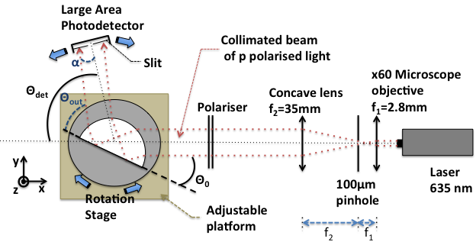
Characterization
Purpose: Design and assemble an automated measurement setup.
Diagram of the experimental setup used for the characterisation of the prisms.

Slide 7
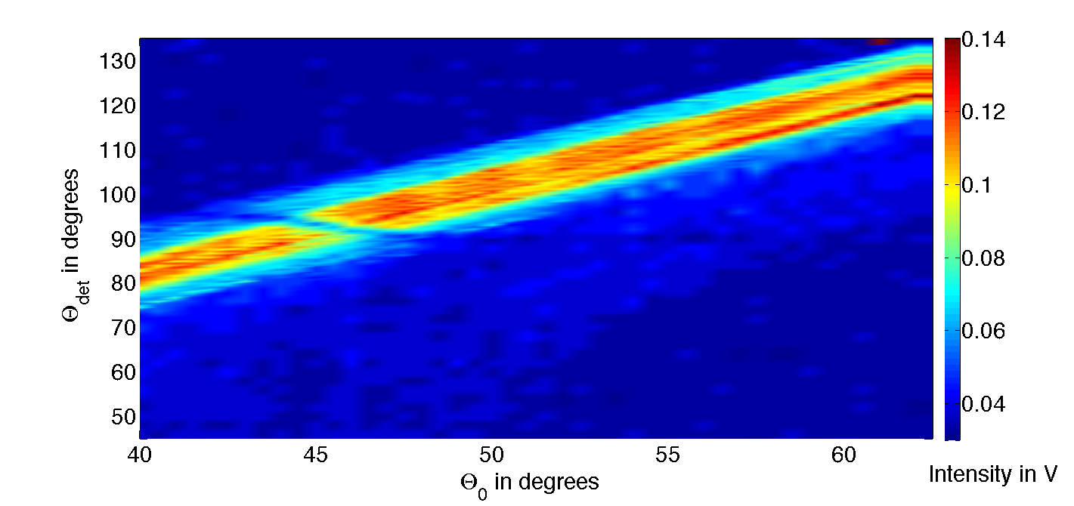
Results
Intensity of the light transmitted from the triangular prism vs. the angle of incidence Θ₀ and the detector position Θ_{det}.

Slide 8
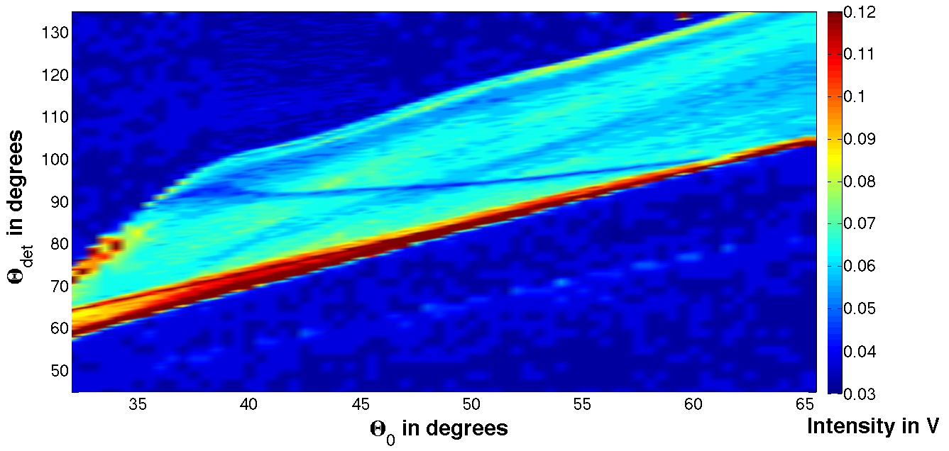
Intensity of the light transmitted from the circular prism vs. the angle of incidence Θ₀ and the detector position Θ_{det}.

Slide 9
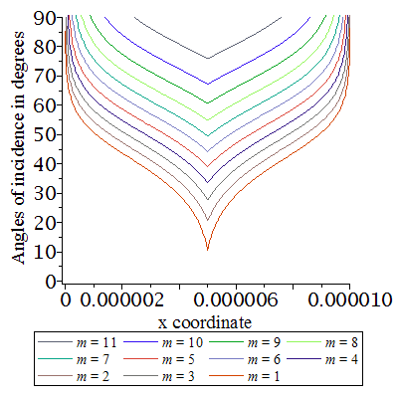
Towards microscopic flexible couplers
Incident light
Incident light
Microscopic array
Single microscopic prism
Need to take into account the different orders of extra momentum increases due to the periodicity.
Angles of incidence that can be coupled
for the microscopic array

Slide 10
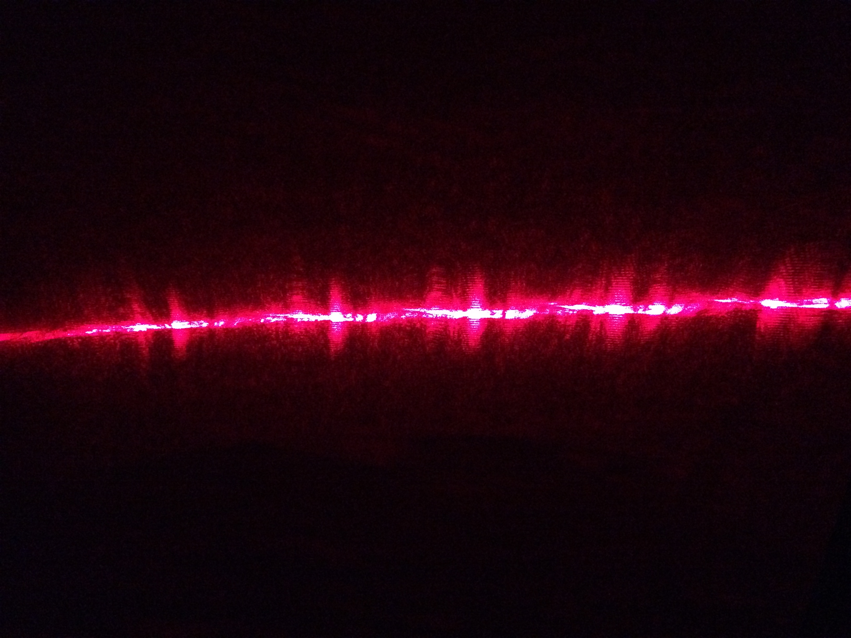
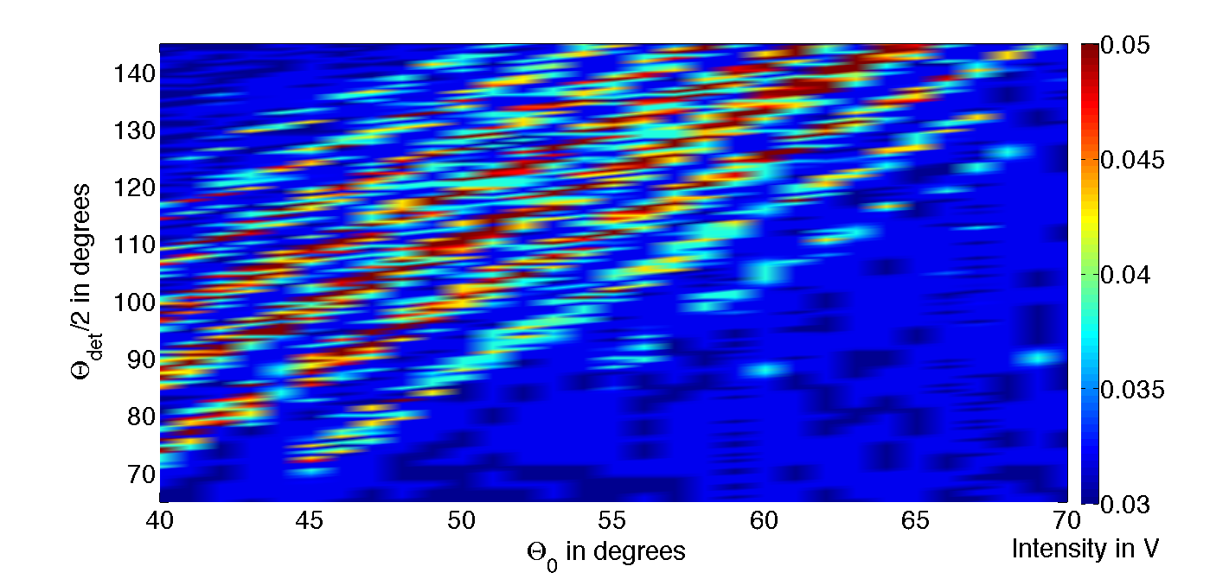
PDMS membrane with an array of microscopic circular prisms
SEM picture of the array
5.11μm
50μm
Picture of the transmitted light beam
Intensity vs. Θ₀ and Θ_{det} for the microscopic array.

Slide 11
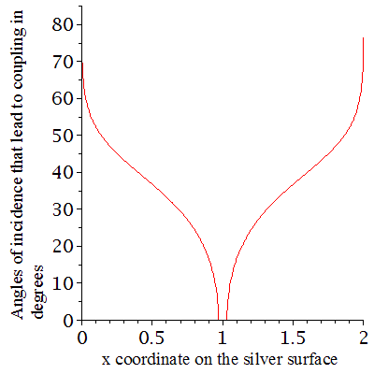
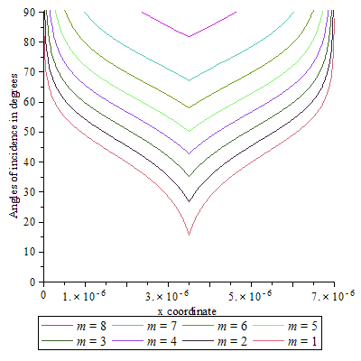
Conclusions and perspective
What we have achieved:
Demonstration of broad angle coupling of SPPs using circular PDMS prisms.
Theoretical demonstration that coupling should still be achievable with microscopic systems.
Fabrication of a membrane with a microscopic array of circular PDMS prisms.
Experimental indications of coupling to the PDMS membrane.
Perspective:
Further develop and investigate the
membrane couplers.
Test these systems at different
wavelengths.
Further engineer the arrangements to
arrive to an efficient, flexible, broad-
angle and broad-band coupler of SPPs.

